Slide 1
15CSE402
Structure and Interpretation of Computer Programs
Modularity Objects and State

Slide 2
Modelling with Mutable Data
To model systems composed of objects that have changing state
need to modify compound data objects
construct and select from them
Additionally mutators are included
Mutable data objects - Data objects for which mutators are defined

Slide 3
Mutable List Structure
Cons, car, and cdr
Basic operations on pairs
Can be used to construct list structure and
Can be used to select parts from list structure
Incapable of modifying list structure

Slide 4
Primitive mutators for pairs
Set-car!
Takes two arguments
First argument must be a pair
Replaces the car pointer by a pointer to the second argument of set-car!

Slide 5
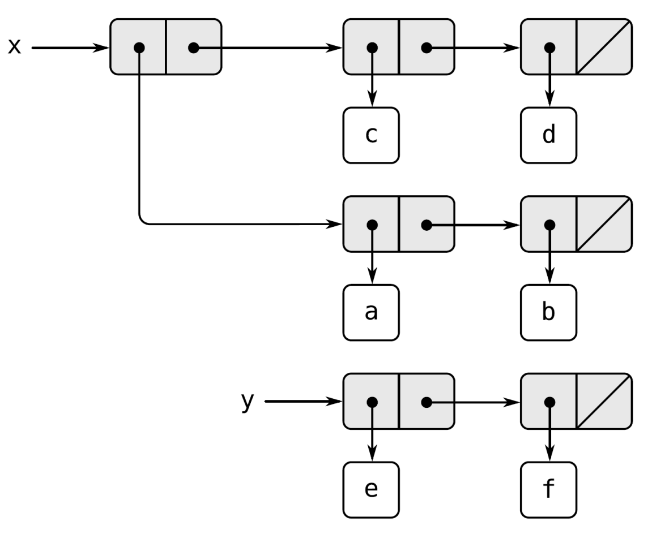
Primitive mutators for pairs
Lists x: ((a b) c d) and y: (e f)

Slide 6
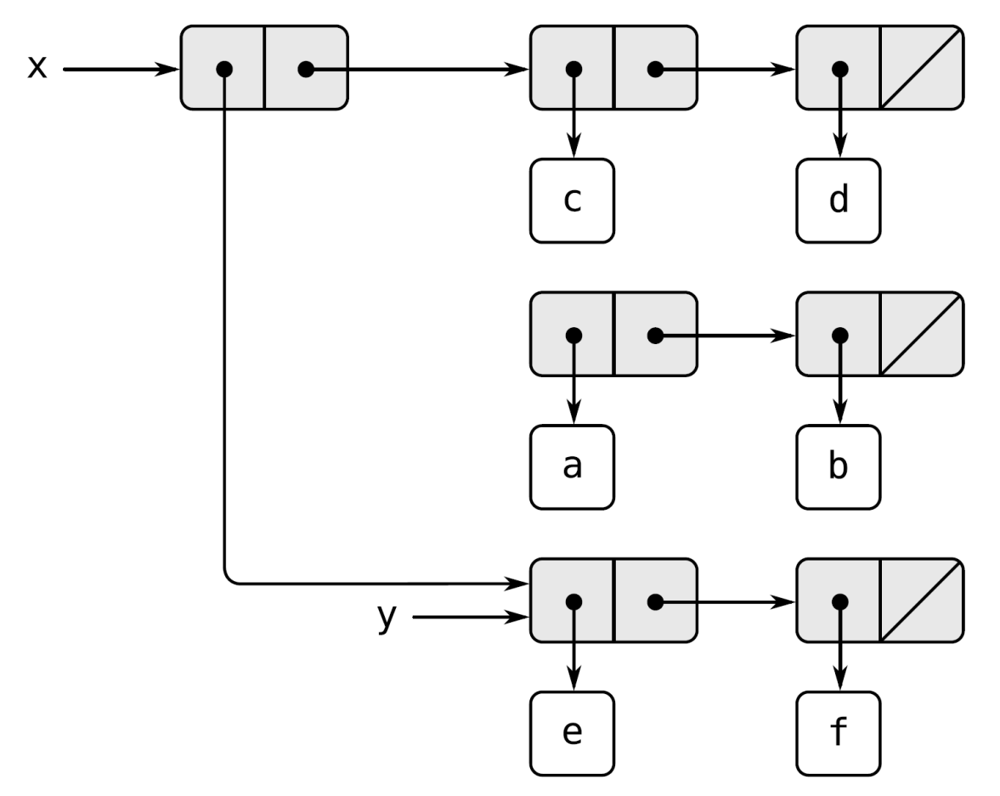
Evaluating (set-car! x y)
Modifies the pair to which x is bound, replacing its car
by the value of y
The pairs representing the list (a b), identified by the pointer that was replaced, are now detached from the original structure
Result: ((e f) c d)

Slide 7
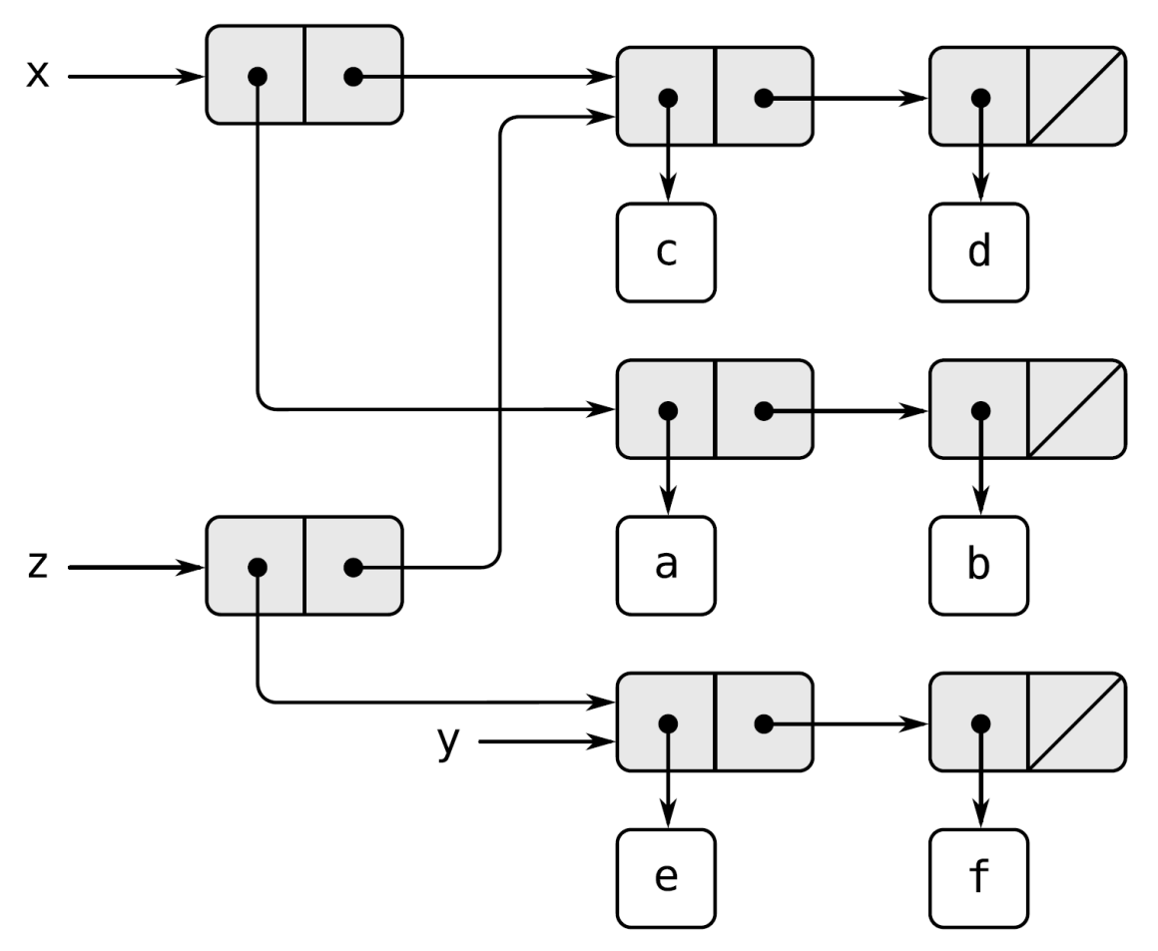
Evaluating (define z (cons y (cdr x)))
z is bound to a new pair created by cons operation
The list to which x is bound is unchanged

Slide 8
Compare set-car! with cons
set-car! and set-cdr! modify existing pairs.
Cons builds new list structure by creating new pairs,

Slide 9
Primitive mutators for pairs
Set-cdr!
Takes two arguments
First argument must be a pair
Replaces the cdr pointer by a pointer to the second argument of set-cdr!

Slide 10
Primitive mutators for pairs
Lists x: ((a b) c d) and y: (e f)

Slide 11
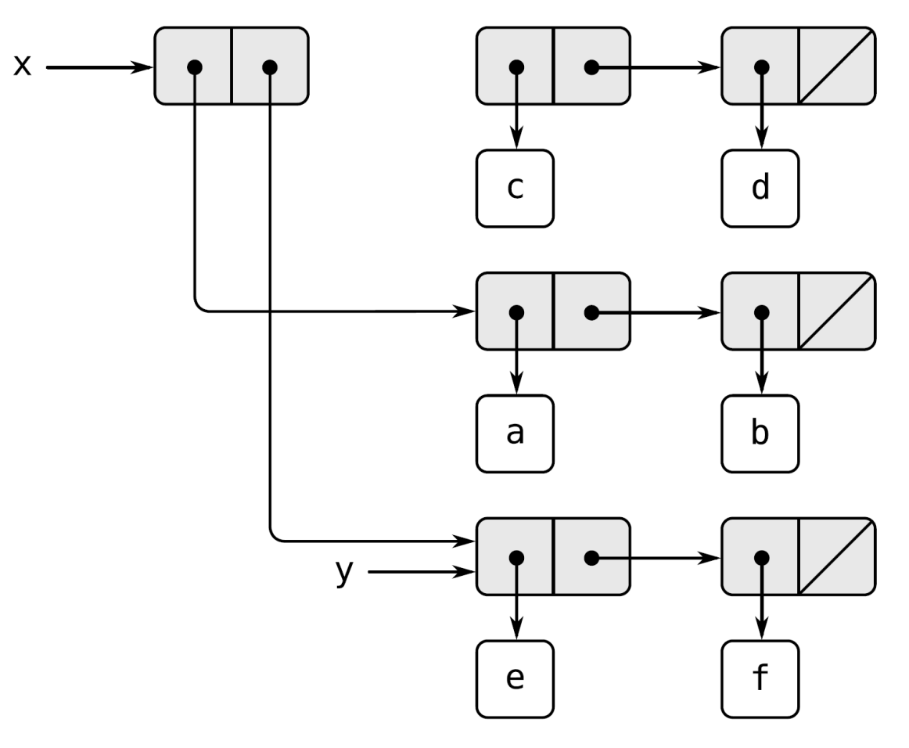
Evaluating (set-cdr! x y)
cdr pointer of x has been replaced by the pointer to
(e f)
the list (c d), which used to be the cdr of x, is now detached
from the structure
Result: ((a b) e f)

Slide 12
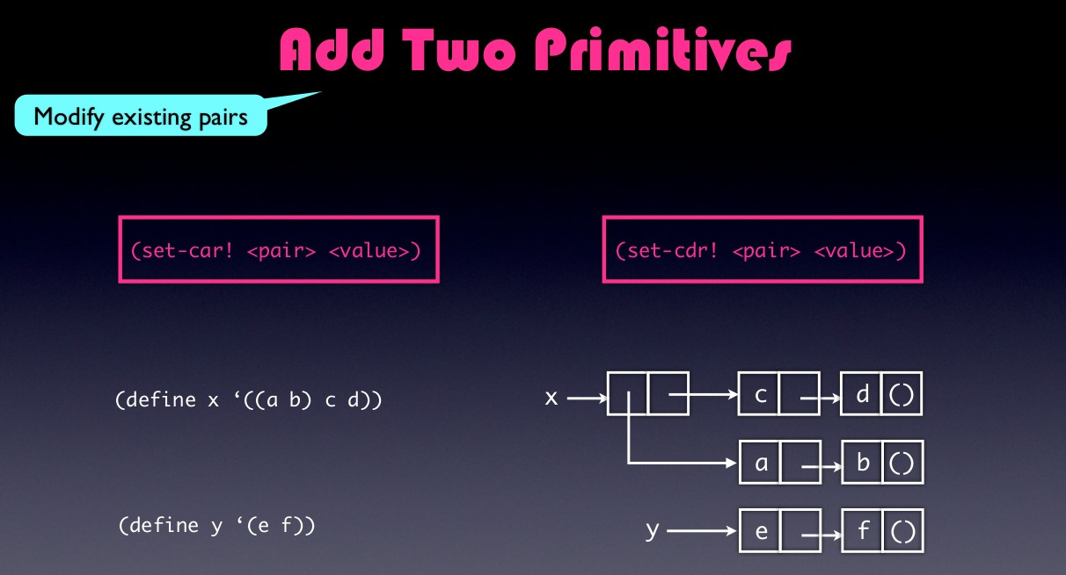

Slide 13
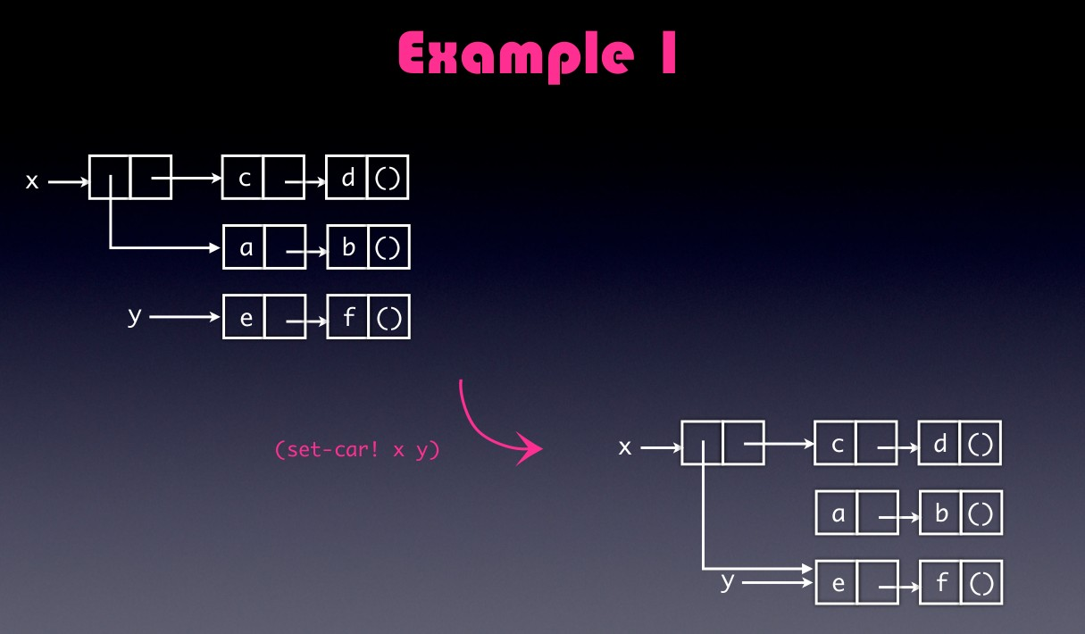

Slide 14
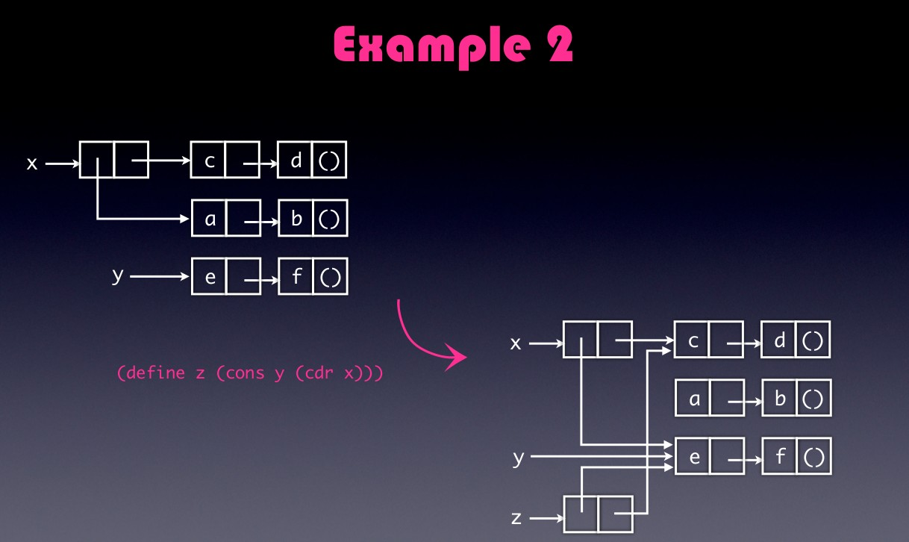

Slide 15
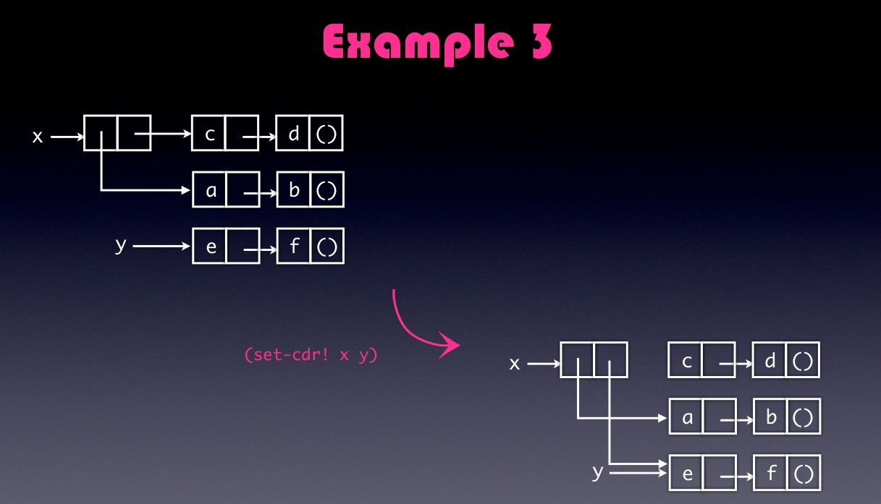

Slide 16
Append lists using mutators
Original append procedure
append procedure
List x={1,2,3} List y={4 5 6}
(define (append x y)
(if (null? x)
y
(cons (car x) (append (cdr x) y))))

Slide 17
Append lists using mutators
New append procedure
List x={1,2,3} List y={4 5 6}
(define (append! x y)
(set-cdr! (last-pair x) y)
x)
(define (last-pair x) --------{3}➔ {3 {}}
(if (null? (cdr x))
x
(last-pair (cdr x))))

Slide 18
Append lists using mutators
New append procedure
List x={1,2,3} List y={4 5 6}
(append listx listy)= {1 2 3 4 5 6}
(append! listx listy)={1 2 3 4 5 6}
(append ‘() listy)=?
(append! ‘() listx)=?

Slide 19
Append lists using mutators
New append procedure
List x={1,2,3} List y={4 5 6}
(append listx listy)=‘(1 2 3 4 5 6)
(append! listx listy)= ‘(1 2 3 4 5 6)
(append ‘() listy)= (4 5 6)
(append! ‘() listx)= ERROR.

Slide 20
Append lists using mutators
(define x (list 'a 'b))
(define y (list 'c 'd))
(define z (append x y))
z ={a b c d}
(cdr x) = (b)
(define w (append! x y))
w= {a b c d}
(cdr x)={b c d}

Slide 21
Append lists using mutators
It only appends the list in the output. Does not modify any of the pointers
(define x (list 'a 'b))
(define y (list 'c 'd))
(define z (append x y))
z = (a b c d)
(cdr x) = (b)
(define w (append! x y))
w= (a b c d)
(cdr x) = (b c d)
Set-cdr! Modifies the pointer of the cdr part of x

Slide 22
Make-cycle using mutators
(define (make-cycle x)
(set-cdr! (last-pair x) x)
x)
(define z (make-cycle (list 'a 'b 'c))) =?
What happens if we try to compute (last-pair z)?

Slide 23
Make-cycle using mutators
(define (make-cycle x)
(set-cdr! (last-pair x) x)
x)
(define z (make-cycle (list 'a 'b 'c))) =
#0=(a b c . #0#)
What happens if we try to compute (last-pair z)?
Infinite loop

Slide 24
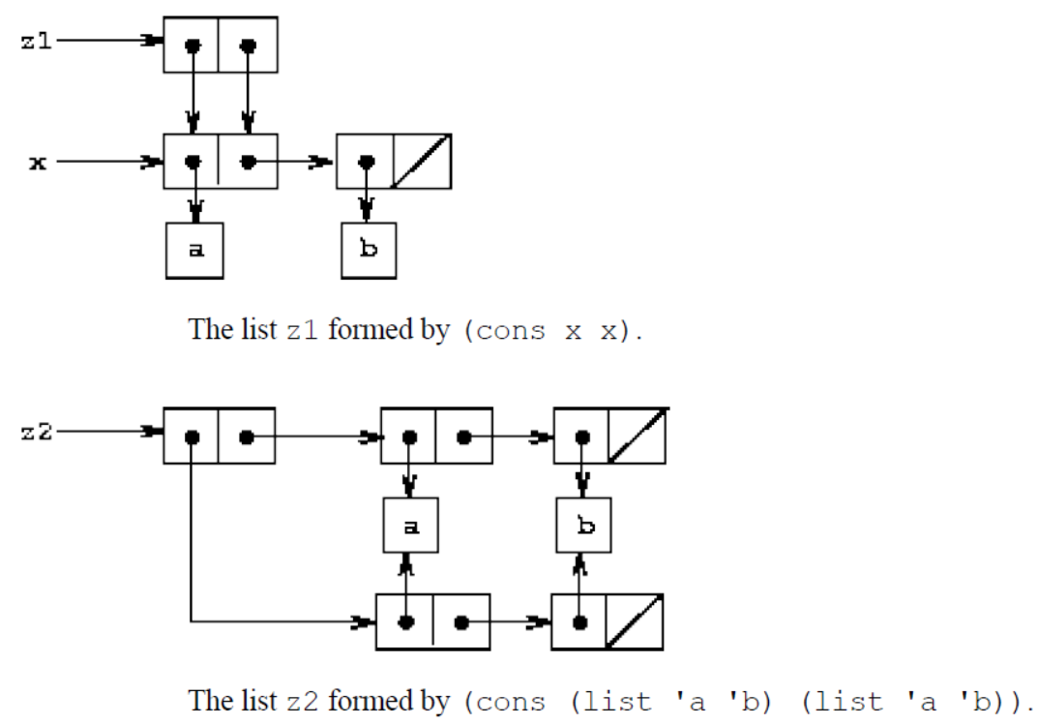
Sharing
(define x (list 'a 'b))
(define z1 (cons x x))

Slide 25
Sharing
(define z2 (cons
(list 'a 'b) (list 'a 'b)))

Slide 26
Sharing and Identity
(define (set-to-wow! x)
(set-car! (car x) 'wow)
x)
z1
((a b) a b)
(set-to-wow! z1) =?
z2
((a b) a b)
(set-to-wow! Z2)=?

Slide 27
Sharing and identity
(define (set-to-wow! x)
(set-car! (car x) 'wow)
x)
z1
((a b) a b)
(set-to-wow! z1)= ((wow b) wow b)
z2
((a b) a b)
(set-to-wow! z2)=((wow b) a b)

Slide 28
Sharing and identity
(eq? (car z1) (cdr z1)) = true
(eq? (car z2) (cdr z2)) =false
Eq? compares two symbols or we can say it compares the respective pointers.

Slide 29
Representing Queues
Representing Queues
A queue is a sequence in which items are
inserted at one end (called the rear of the queue) and
deleted from the other end (the front).

Slide 30
Representing Queues
Operation Resulting Queues
(define q (make-queue)
(insert-queue! q 'a) a
(insert-queue! q 'b) a b
(delete-queue! q) b
(insert-queue! q 'c) b c
(insert-queue! q 'd) b c d
(delete-queue! q) c d

Slide 31
Representing Queues
Constructor
(make-queue)-returns an empty queue
Selector
(empty-queue? <queue>)
(front-queue! <queue>)
Mutators
(insert-queue! <queue> <item>)
(delete-queue! <queue>)

Slide 32
Representing Queues
Since queue is a sequence of items,
it can be represented as an ordinary list
the front of the queue is the car of the list
Inserting an item is appending a new element at the end of the list
deleting an item is taking the cdr of the list.

Slide 33
Inefficient Representation
To insert an item –
scan the list and reach the end
θ(n) steps for a list of n items
Representing queue as a pair of pointers front-ptr and rear-ptr makes insertion as an operation requiring θ(1) steps
cons is used to combine the two pointers.
the queue itself will be the cons of the two pointers

Slide 34
Implementing Queues
queue
front-ptr
rear-ptr
a
b
c
()
Queues are realized using a pair of pointers
‘queue’ pair (front-ptr and rear-ptr)
And a list of items
(a, b, c)

Slide 35
front-ptr
(define (front-ptr queue)

Slide 36
front-ptr
(define (front-ptr queue) (car queue))

Slide 37
front-ptr
(define (front-ptr queue) (car queue))
(define (set-front-ptr! queue item)

Slide 38
Implementing Queues
queue
front-ptr
rear-ptr
a
b
c
()

Slide 39
front-ptr
(define (front-ptr queue) (car queue))
(define (set-front-ptr! queue item) (set-car! queue item))

Slide 40
rear-ptr
(define (rear-ptr queue) (cdr queue))
(define (set-rear-ptr! queue item) (set-cdr! queue item))

Slide 41
rear-ptr
(define (rear-ptr queue) (cdr queue))
(define (set-rear-ptr! queue item) (set-cdr! queue item))

Slide 42
Representing Queues
(make-queue) (empty-queue? (front-queue!
<queue>)
<queue>)
(insert-queue! <queue> <item>) (delete-queue! <queue>)

Slide 43
make-queue
(define (make-queue)

Slide 44
make-queue
Initialization of Queue
(define (make-queue) (cons '() '()))
An empty queue: A pair with no data and empty front-ptr and end-ptr

Slide 45
make-queue
(define (make-queue) (cons '() '()))
(define queue (make-queue)
queue
()
()

Slide 46
Representing Queues
(make-queue) (empty-queue? (front-queue!
<queue>)
<queue>)
(insert-queue! <queue> <item>) (delete-queue! <queue>)

Slide 47
Implementing Queues
queue
front-ptr
rear-ptr
a
b
c
()

Slide 48
empty-queue?
(define (empty-queue? queue)

Slide 49
empty-queue?
(define (empty-queue? queue) (null? (front-ptr queue)))

Slide 50
Representing Queues
(make-queue) (empty-queue? (front-queue!
<queue>)
<queue>)
(insert-queue! <queue> <item>) (delete-queue! <queue>)

Slide 51
Implementing Queues
queue
front-ptr
rear-ptr
a
b
c
()

Slide 52
front-queue
(define (front-queue queue)

Slide 53
front-queue
(define (front-queue queue) (car (front-ptr queue)))

Slide 54
front-queue
(define (front-queue queue) (if (empty-queue? Queue)
(error “Empty Queue” queue) (car (front-ptr queue))))

Slide 55
Representing Queues
(make-queue) (empty-queue? (front-queue!
<queue>)
<queue>)
(insert-queue! <queue> <item>) (delete-queue! <queue>)

Slide 56
Implementing Queues
queue
front-ptr
rear-ptr
a
b
c
()

Slide 57
Implementing Queues
queue
front-ptr
rear-ptr
a
b
c
()
item
()

Slide 58
Implementing Queues
queue
front-ptr
rear-ptr
a
b
c
()
item
()
(cons item '())

Slide 59
Implementing Queues
queue
front-ptr
rear-ptr
a
b
c
()
item
()
(let ((new-pair (cons item '())))

Slide 60
Implementing Queues
queue
front-ptr
rear-ptr
a
b
c
item
()

Slide 61
Implementing Queues
queue
front-ptr
rear-ptr
a
b
c
item
()
(rear-ptr queue)

Slide 62
Implementing Queues
queue
front-ptr
rear-ptr
a
b
c
item
()
(set-cdr! (rear-ptr queue) new-pair)

Slide 63
Implementing Queues
queue
front-ptr
rear-ptr
a
b
c
item
()
(set-rear-ptr! queue new-pair)

Slide 64
insert-queue!
(define (insert-queue! queue item) (let ((new-pair (cons item '())))
(cond (??)
(else
(set-cdr! (rear-ptr queue)
new-pair)
(set-rear-ptr! queue new-pair) queue))))

Slide 65
What if?
rear-ptr
queue
()
()
front-ptr

Slide 66
What if?
rear-ptr
queue
()
()
front-ptr
item
()

Slide 67
What if?
rear-ptr
queue
()
front-ptr
item
()

Slide 68
What if?
rear-ptr
queue
()
front-ptr
item
()
(set-front-ptr! queue new-pair)

Slide 69
What if?
rear-ptr
queue
front-ptr
item
()
(set-front-ptr! queue new-pair)

Slide 70
What if?
rear-ptr
queue
front-ptr
item
()
(set-front-ptr! queue new-pair) (set-rear-ptr! queue new-pair)

Slide 71
insert-queue!
(define (insert-queue! queue item) (let ((new-pair (cons item '())))
(cond ((empty-queue? Queue) (set-front-ptr! queue
new-pair)
(set-rear-ptr! queue new-pair) queue)
(else
(set-cdr! (rear-ptr queue)
new-pair)
(set-rear-ptr! queue new-pair) queue))))

Slide 72
Representing Queues
(make-queue) (empty-queue? (front-queue!
<queue>)
<queue>)
(insert-queue! <queue> <item>) (delete-queue! <queue>)

Slide 73
Implementing Queues
queue
front-ptr
rear-ptr
a
b
c
()

Slide 74
Implementing Queues
queue
front-ptr
rear-ptr
a
b
c
()

Slide 75
delete-queue!
(define (delete-queue! queue) (cond ((empty-queue? queue)
(error “Empty Queue” queue) (else
(set-front-ptr! queue
(cdr (front-ptr queue))) queue)))

Slide 76
Tables – One Dimensional
Each value is stored under a single key
Implemented as a list of records
Each record – Key, Value Pair
Records are glued to form a list
Gluing pairs – backbone of the table
Implemented as a headed list to have a place to change when a new record is added
Headed list – has a special backbone pair - *table* which holds dummy record

Slide 77
Representing 1-D Tables
table
*table*
a
1
b
2
c
3

Slide 78
Representing 1-D Tables
1- Dimensional Table
a : 1
b : 2
c : 3
table
*table*
a
1
b
2
c
3

Slide 79
make-table
Creating a new table:
(define (make-table)
(list '*table*))

Slide 80
lookup
1. Searches for a record with a given ‘key’ in the table.
2. LOOKUP is implemented with help of an ‘assoc’ procedure.
3. ‘Assoc’ returns FALSE if record not present.
Otherwise it returns the KEY-VALUE PAIR.

Slide 81
assoc
(define (assoc key records) (cond ((null? records) false)
((equal? key (caar records)) (car records)
(else (assoc key (cdr records)))
))
# Search for b, assoc returns (b:2)
table
*table*
a
1
b
2
c
3

Slide 82
lookup
(define (lookup key table)
(let ((record (assoc key (cdr table)))) (if record
(cdr record) false)))
# Returns ‘2’ as the output

Slide 83
insert!
If ‘key’ already exists, then insert! Sets its CDR part.
If ‘key’ doesn’t exist, create a new pair and insert at the beginning of table.
(define (insert! key value table)
(let ((record (assoc key (cdr table)))) (if record
(set-cdr! record value) (set-cdr! table
(cons (cons key value) (cdr table)))))

Slide 84
Two Dimensional Tables
Each value is indexed by two keys.
Constructed as one-dimensional table in which each key identifies a sub-table
Example: Math and letter sub-table (in next slide)
The sub-tables don’t need a special header symbol
The key that identifies the sub-table serves as header.

Slide 85
Representing 2-D Tables
math:
+: 43
-: 45
*: 42
letters:
a: 97
b: 98
It is represented as two subtables

Slide 86
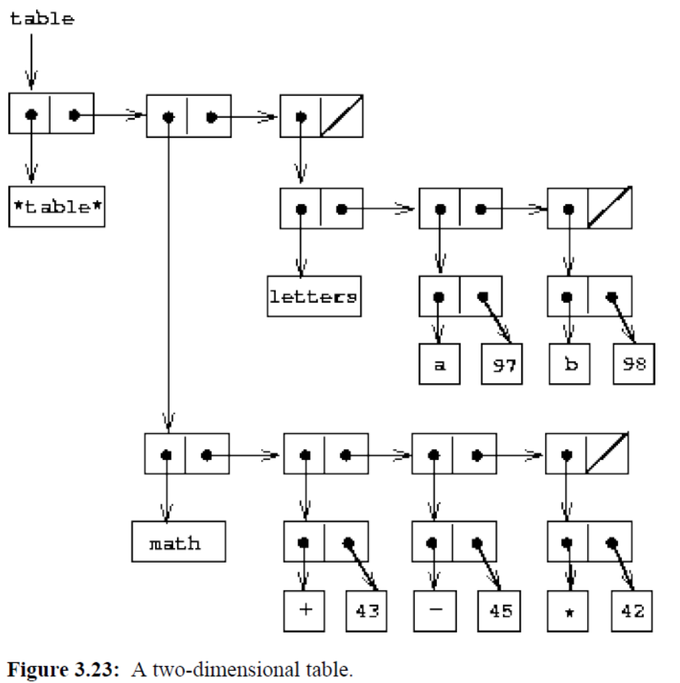
Representing 2-D Tables

Slide 87
lookup
To look up an item, use the first key to identify the correct subtable.
Then use the second key to identify the record within the subtable.

Slide 88
lookup
(define (lookup key-1 key-2 table)
(let ((subtable (assoc key-1 (cdr table))))
(if subtable
(let ((record (assoc key-2 (cdr subtable))))
(if record
(cdr record)
false))
false)))
First looks for subtable.
Then searches for records

Slide 89
Insert!
To insert a new item under a pair of keys, use assoc to see if there is a subtable stored under the first key.
If not, build a new subtable containing the single record (key-2, value) and insert it into the table under the first key.
If a sub-table already exists for the first key, insert the new
record into this sub-table, using the insertion method for
one-dimensional tables.

Slide 90
insert
(define (insert! key-1 key-2 value table)
(let ((subtable (assoc key-1 (cdr table))))
(if subtable
(let ((record (assoc key-2 (cdr subtable))))
(if record (set-cdr! record value)
(set-cdr! Subtable (cons (cons key-2 value)(cdr subtable)))))
(set-cdr! table
(cons (list key-1
(cons key-2 value))
(cdr table)))))
'ok)

Slide 91
Creating Local Tables
(define (make-table)
(let ((local-table (list ’*table*)))
(define (lookup key-1 key-2)
(let ((subtable (assoc key-1 (cdr local-table))))
(if subtable
(let ((record (assoc key-2 (cdr subtable))))
(if record
(cdr record)
false))
false)))
(define (insert! key-1 key-2 value)
(let ((subtable (assoc key-1 (cdr local-table))))
(if subtable
(let ((record (assoc key-2 (cdr subtable))))
(if record
(set-cdr! record value)
(set-cdr! subtable
(cons (cons key-2 value)
(cdr subtable)))))
(set-cdr! local-table
(cons (list key-1
(cons key-2 value))
(cdr local-table)))))
’ok)
(define (dispatch m)
(cond ((eq? m ’lookup-proc) lookup)
((eq? m ’insert-proc!) insert!)
(else (error "Unknown operation - TABLE" m))))
dispatch))

